Slide 1

Breast Cancer Tumor Board Preventive Surgery
BIO-698
Nikita Norkin
09.11.2023
Notes:
Dear Roger, thank you very much for giving me the opportunity to present here today in your class. The subject of my talk is breast cancer and ways of its diagnosis and prevention.
This important subject has recently caught quite some attention due to the decision of Angelina Jolly to undergo preventive surgery after she learned that she carried mutations in genes associated with a high risk of developing the breast cancer. Her revelation has produced the so-called “Angelina Effect” as coined by the TIME magazine. This effect lies in the increase in referrals of women with a family history of breast cancer, and an increase in genetic testing and an increase in the cases of preventive surgery.

Slide 2
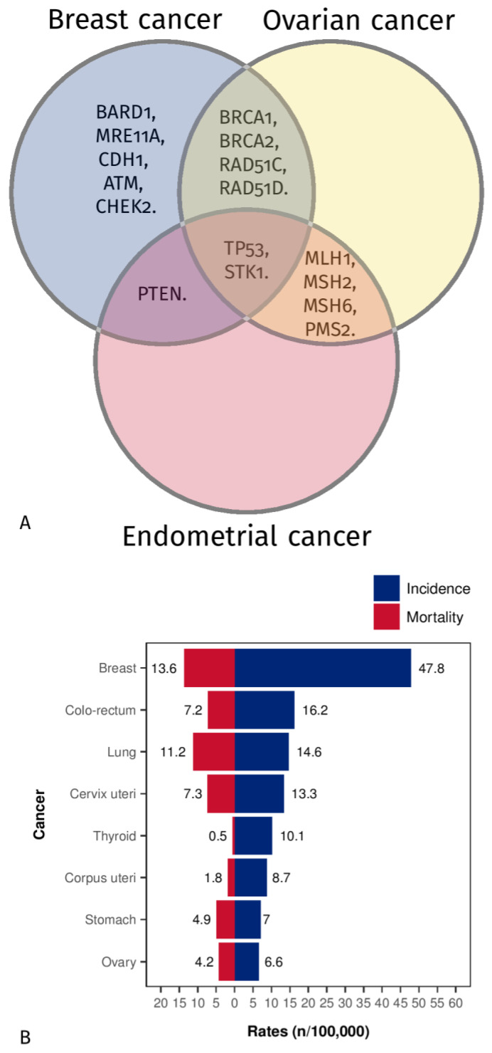
Cancers in Female Population
2020
Breast cancer
1990 to 2019
J. Clin. Med. 2023, 12, 1422. https://doi.org/10.3390/jcm12041422
Xu, Y., Gong, M., Wang, Y. et al. Global trends and forecasts of breast cancer incidence and deaths. Sci Data 10, 334 (2023). https://doi.org/10.1038/s41597-023-02253-5
Notes:
The plot on the right shows the incidence and mortality rates for various cancer types and the map on the left shows the relative change in diagnosed breast cancer cases in 2019 compared to 1990. Indeed, the breast cancer is not only very serious condition with a high incidence and mortality rates but it is also on the rise.
Figure 1. (A) Venn diagram showing mutated predisposing genes shared among hereditary ovarian,
breast, and endometrial cancer [7]. (B) Estimated global age-standardized tumor incidences and
mortality rates (female population only) according to GLOBOCAN data in 2020 (www.iarc.fr---World
Health Organisation (WHO), access on 22 November 2022)
Fig. 1 Global GBD and temporal trends of BC incidence in 204 countries or territories. ASR: age standardized rate; BC: breast cancer; EAPC: estimated annual percentage change; GBD: global burden of disease. (a) Te ASR per 100,000 people in 1990; (b) Te ASR per 100,000 people in 2019; (c) Te change in cancer cases; (d) EAPC in diferent countries or territories.

Slide 3
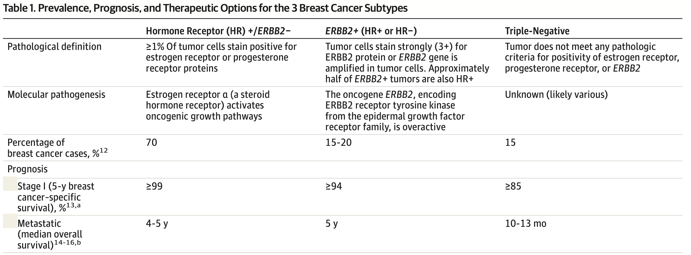
Breast Cancer Subtypes
Waks AG, Winer EP. Breast Cancer Treatment: A Review. JAMA. 2019;321(3):288–300. doi:10.1001/jama.2018.19323
Notes:
Human epidermal growth factor 2
Hormone receptor positive (estrogen or progesterone)
Breast cancer is a histologic diagnosis made according to standard- ized pathologic criteria. The most common breast cancer histology is invasive ductal carcinoma (50%-75% of patients), followed by invasive lobular carcinoma (5%-15% of patients), with mixed ductal/ lobular carcinomas and other rarer histologies making up the re- mainder of patients.5
Two main molecular targets in breast cancer pathogenesis have been identified. One is estrogen receptor alpha (ERα), which is ex- pressed in approximately 70% of invasive breast cancers. ERα is a steroid hormone receptor and a transcription factor that, when ac- tivated by estrogen, activates oncogenic growth pathways in breast cancer cells. Expression of the closely related steroid hormone pro- gesterone receptor (PR) is also a marker of ERα signaling.6 Tumors with expression of either estrogen receptor (ER) or PR in at least 1% of tumor cells are categorized as HR+.7 The use of endocrine agents to downregulate ER signaling is the primary systemic therapy for ER-positive or PR-positive breast cancers.
The second main molecular target is epidermal growth factor 2 (ERBB2, formerly HER2 or HER2/neu), a transmembrane receptor tyrosine kinase in the epidermal growth factor receptor family that is amplified or overexpressed in approximately 20% of breast can- cers, and is associated with poor prognosis in the absence of sys- temic therapy.8 Tumors with amplification or overexpression of the gene ERBB2 are ERBB2+.9 Patients with ERBB2-amplified or -overexpressing breast cancer benefit from ERBB2-targeted therapy, including anti-ERBB2 antibodies (such as trastuzumab and pertuzumab) and small-molecule tyrosine kinase inhibitors (such as lapatinib and neratinib).
Triple-negative breast cancer, which makes up approximately 15% of all breast tumors,10 is characterized by the lack of expres- sion of molecular targets ER, PR, or ERBB2. Triple-negative tumors have a high risk of distant relapse in the first 3 to 5 years following diagnosis.11 The specific molecular pathophysiology of triple- negative breast cancer remains poorly understood.
Distinct prevalences, prognoses, and systemic therapy op- tions characterize the 3 breast cancer subtypes: HR+, ERBB2+, or triple-negative (Table 1). Triple-negative breast tumors are more likely to occur in women who are younger, black, or Hispanic,11 whereas HR+ tumors are more likely in older women. Breast cancer
is staged I-IV, where IV denotes distant metastatic disease. Stage I breast cancers, defined anatomically as a breast tumor smaller than 2 cm and no lymph node involvement, have 5-year breast cancer– specific survival of at least 99%, at least 94%, and at least 85% for HR+, ERBB2+, and triple-negative subtypes, respectively. Stage IV breast cancers have median overall survival of approximately 5 years for HR+ or ERBB2+ subtypes and 1 year for triple-negative.13-16
For nonmetastatic breast cancer, the main goals of therapy are eradi- cating tumor from the breast and regional lymph nodes and pre- venting metastatic recurrence. Local therapy for nonmetastatic breast cancer consists of surgical resection and sampling or re- moval of axillary lymph nodes, with consideration of postoperative radiation. Systemic therapy may be preoperative (neoadjuvant), postoperative (adjuvant), or both. Breast cancer subtype guides the standard systemic therapy administered (Table 1), which consists of endocrine therapy for all HR+ tumors (with some patients requir- ing chemotherapy as well), trastuzumab-based ERBB2-directed an- tibody therapy plus chemotherapy for all ERBB2+ tumors (with en- docrine therapy given in addition, if concurrent HR positivity), and chemotherapy alone for triple-negative breast cancer.
For metastatic breast cancer, therapeutic goals are prolonging life and symptom palliation. Currently, metastatic breast cancer re- mains incurable in virtually all affected patients. The same basic cat- egories of systemic therapy are used in metastatic breast cancer as in neoadjuvant/adjuvant approaches outlined here. Local therapy modalities (surgery and radiation) are typically used for palliation only in metastatic disease.

Slide 4
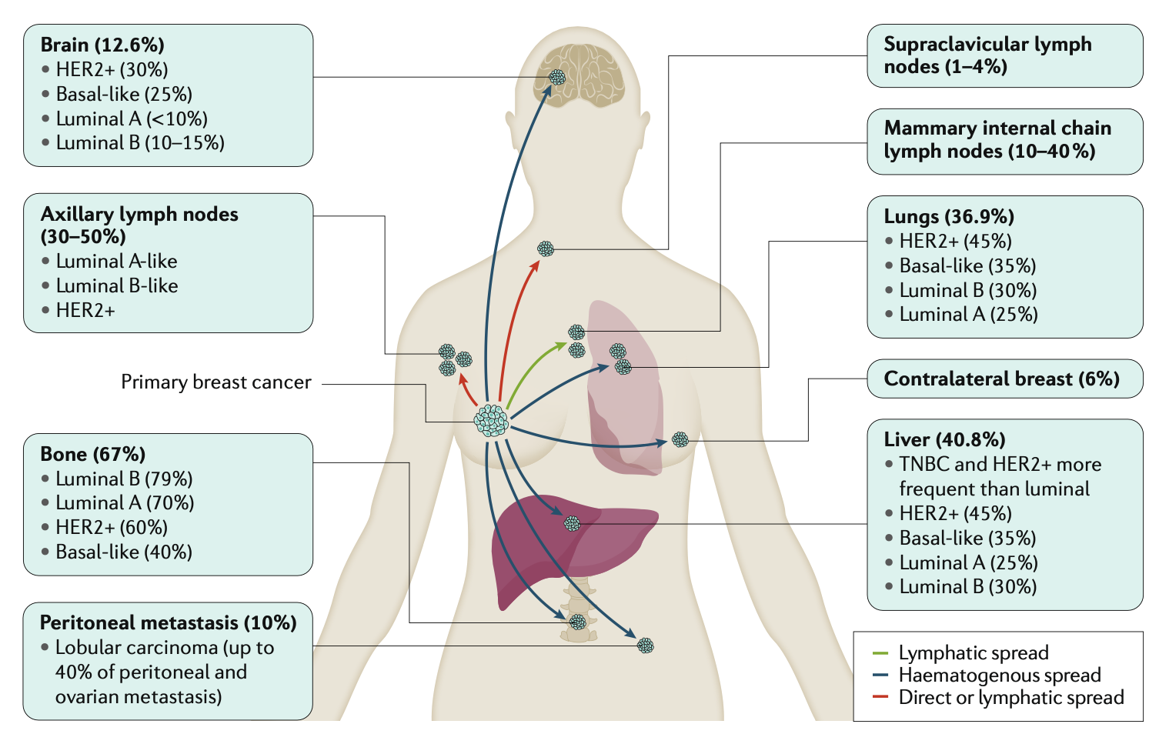
Invasive Breast Cancer
Harbeck, N., Penault-Llorca, F., Cortes, J. et al. Breast cancer. Nat Rev Dis Primers 5, 66 (2019). https://doi.org/10.1038/s41572-019-0111-2
Notes:
Human epidermal growth factor 2
Hormone receptor positive (estrogen or progesterone)
Breast cancer is a histologic diagnosis made according to standard- ized pathologic criteria. The most common breast cancer histology is invasive ductal carcinoma (50%-75% of patients), followed by invasive lobular carcinoma (5%-15% of patients), with mixed ductal/ lobular carcinomas and other rarer histologies making up the re- mainder of patients.5
Two main molecular targets in breast cancer pathogenesis have been identified. One is estrogen receptor alpha (ERα), which is ex- pressed in approximately 70% of invasive breast cancers. ERα is a steroid hormone receptor and a transcription factor that, when ac- tivated by estrogen, activates oncogenic growth pathways in breast cancer cells. Expression of the closely related steroid hormone pro- gesterone receptor (PR) is also a marker of ERα signaling.6 Tumors with expression of either estrogen receptor (ER) or PR in at least 1% of tumor cells are categorized as HR+.7 The use of endocrine agents to downregulate ER signaling is the primary systemic therapy for ER-positive or PR-positive breast cancers.
The second main molecular target is epidermal growth factor 2 (ERBB2, formerly HER2 or HER2/neu), a transmembrane receptor tyrosine kinase in the epidermal growth factor receptor family that is amplified or overexpressed in approximately 20% of breast can- cers, and is associated with poor prognosis in the absence of sys- temic therapy.8 Tumors with amplification or overexpression of the gene ERBB2 are ERBB2+.9 Patients with ERBB2-amplified or -overexpressing breast cancer benefit from ERBB2-targeted therapy, including anti-ERBB2 antibodies (such as trastuzumab and pertuzumab) and small-molecule tyrosine kinase inhibitors (such as lapatinib and neratinib).
Triple-negative breast cancer, which makes up approximately 15% of all breast tumors,10 is characterized by the lack of expres- sion of molecular targets ER, PR, or ERBB2. Triple-negative tumors have a high risk of distant relapse in the first 3 to 5 years following diagnosis.11 The specific molecular pathophysiology of triple- negative breast cancer remains poorly understood.
Distinct prevalences, prognoses, and systemic therapy op- tions characterize the 3 breast cancer subtypes: HR+, ERBB2+, or triple-negative (Table 1). Triple-negative breast tumors are more likely to occur in women who are younger, black, or Hispanic,11 whereas HR+ tumors are more likely in older women. Breast cancer
is staged I-IV, where IV denotes distant metastatic disease. Stage I breast cancers, defined anatomically as a breast tumor smaller than 2 cm and no lymph node involvement, have 5-year breast cancer– specific survival of at least 99%, at least 94%, and at least 85% for HR+, ERBB2+, and triple-negative subtypes, respectively. Stage IV breast cancers have median overall survival of approximately 5 years for HR+ or ERBB2+ subtypes and 1 year for triple-negative.13-16
For nonmetastatic breast cancer, the main goals of therapy are eradi- cating tumor from the breast and regional lymph nodes and pre- venting metastatic recurrence. Local therapy for nonmetastatic breast cancer consists of surgical resection and sampling or re- moval of axillary lymph nodes, with consideration of postoperative radiation. Systemic therapy may be preoperative (neoadjuvant), postoperative (adjuvant), or both. Breast cancer subtype guides the standard systemic therapy administered (Table 1), which consists of endocrine therapy for all HR+ tumors (with some patients requir- ing chemotherapy as well), trastuzumab-based ERBB2-directed an- tibody therapy plus chemotherapy for all ERBB2+ tumors (with en- docrine therapy given in addition, if concurrent HR positivity), and chemotherapy alone for triple-negative breast cancer.
For metastatic breast cancer, therapeutic goals are prolonging life and symptom palliation. Currently, metastatic breast cancer re- mains incurable in virtually all affected patients. The same basic cat- egories of systemic therapy are used in metastatic breast cancer as in neoadjuvant/adjuvant approaches outlined here. Local therapy modalities (surgery and radiation) are typically used for palliation only in metastatic disease.

Slide 5
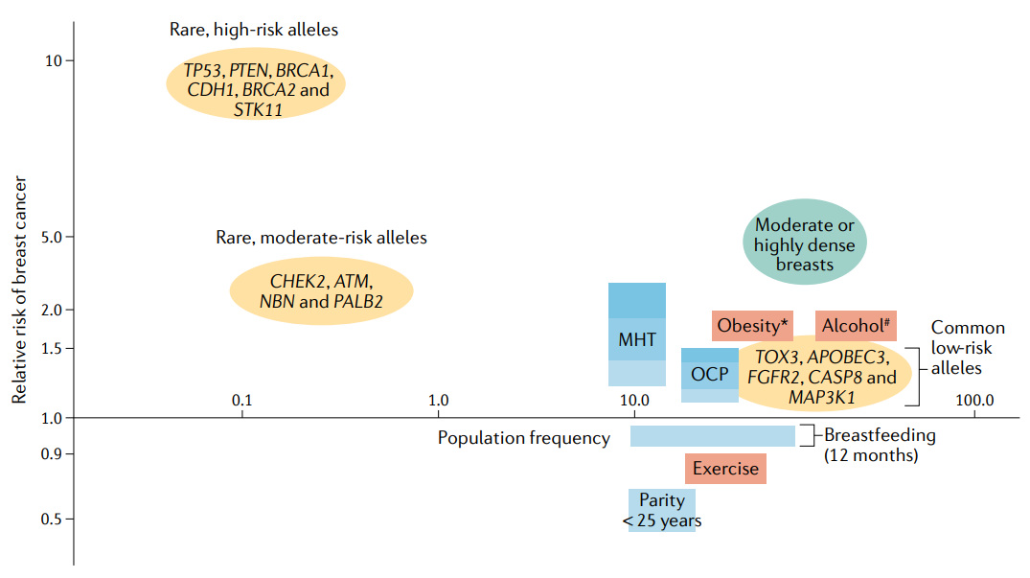
Breast Cancer Risk Modifiers
MHT - menopausal hormone therapy
OCP - oral contraceptive pill
Britt, K.L., Cuzick, J. & Phillips, KA. Key steps for effective breast cancer prevention. Nat Rev Cancer 20, 417–436 (2020). https://doi.org/10.1038/s41568-020-0266-x
Notes:
Among factors that contribute to the risk of developing the breast cancer is the genetic predisposition with three distinct groups– high, moderate and low-risk mutations.
Other factors include lifestyle factors such as alcohol consumption, dietary choices, exercise as well as reproductive strategies.
Fig. 1 | Breast cancer risk modifiers and population frequency. The population frequency (x axis) of genetic and nongenetic breast cancer risk modifiers is shown with their effects on, or associations with, the relative risk (RR) of breast cancer (y axis). Rare, high-risk alleles are shown, as are rare, moderate-risk alleles considered to have sufficient evidence to support their association. Examples of common low-penetrance variants, of which there are now several hundred, are also listed18,19,21–23. For menopausal hormone therapy (MHT) and oral contraceptive pill (OCP) use, combined oestrogen and progestogen therapy is assumed; dark blue denotes risk for current, long-term users, mid blue denotes shorter periods of use and light blue denotes past users33,264,265. *Refers only to postmenopausal obesity266. #Refers to 2 glasses of alcohol per day, which is the average consumption level in the 72% of the high socio-demographic index population who are drinkers134,144. Exercise refers to most active compared with least physically active124. The RR reduction associated with breastfeeding is for 12 months of cumulative breastfeeding31. Parity refers to a first full-term childbirth prior to 25 years of age35. The RR of breast cancer in women with moderate to high mammographic density (>25% to >75% density) is 1.8–6.0 compared with women with low mammographic density104. Currently, 50% of the female population in high-income countries are considered to have moderate (25–50%) to high (>75%) breast density107. Orange shapes refer to genetic risk factors, blue shapes to reproductive risk factors and pink shapes to lifestyle factors. APOBEC3, apolipoprotein B mRNA editing enzyme catalytic polypeptide-like; ATM, ataxia telangiectasia mutated; CASP8, caspase 8; CDH1, cadherin 1; CHEK2, checkpoint kinase 2; FGFR2, fibroblast growth factor receptor 2; NBN, nibrin; PALB2, partner and localizer of BRCA2; STK11, serine/threonine protein kinase 11.

Slide 6
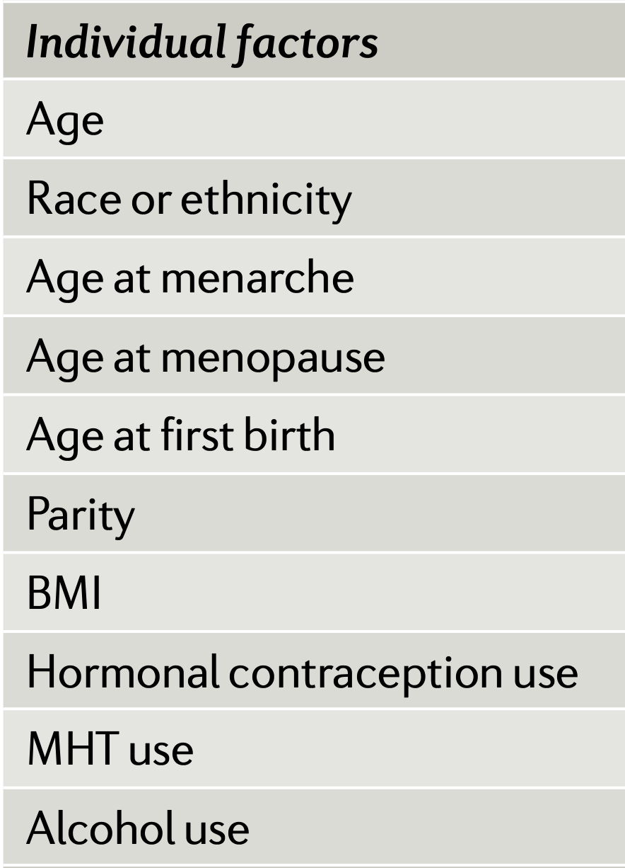
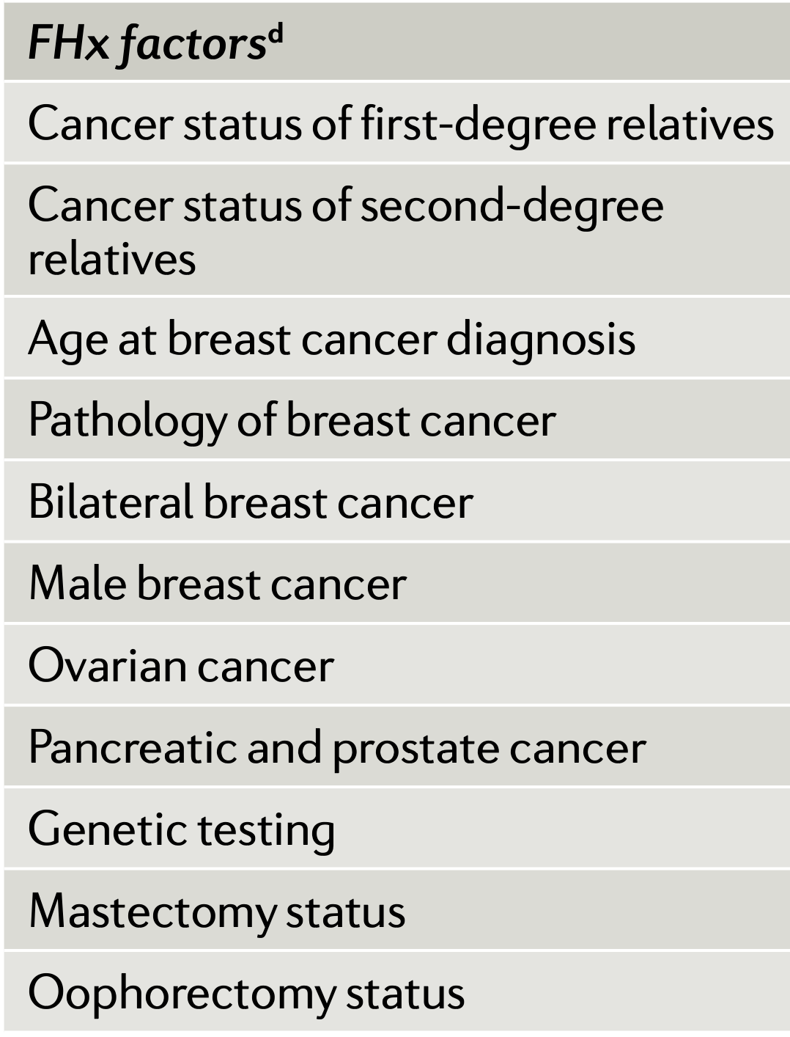
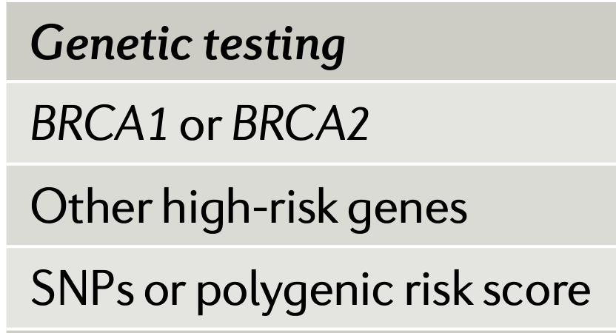
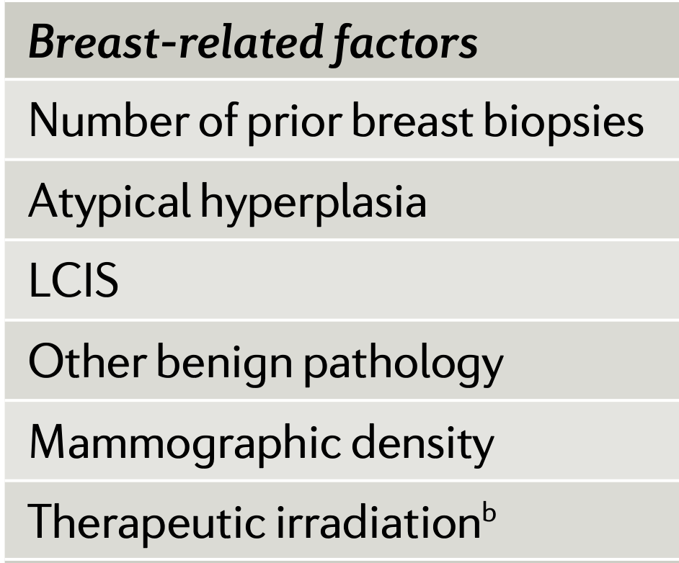
Risk Assessment
Family History
Britt, K.L., Cuzick, J. & Phillips, KA. Key steps for effective breast cancer prevention. Nat Rev Cancer 20, 417–436 (2020). https://doi.org/10.1038/s41568-020-0266-x
Notes:
In clinic, the risk assessment is based on scoring individual factors, factors related to family history, as well as results of medical examination. One of the crucial recent additions are the results of genetic testing, in particular testing for BRCA1 and BRCA2 gene mutations.
Web links to the online risk estimation models can be found in Related Links box. +, input possible; BCRAT, Breast Cancer Risk
Assessment Tool; BCSC, Breast Cancer Surveillance Consortium; BMI, body mass index; BOADICEA, Breast and Ovarian Analysis
of Disease Incidence and Carrier Estimation Algorithm; FHx, family history; IBIS, International Breast Cancer Intervention Study;
LCIS, lobular carcinoma in situ; MHT, menopausal hormone therapy; NA, not applicable; SNP, single- nucleotide polymorphism.
aBRCAPRO is a statistical model, with associated software, for assessing the probability that an individual carries a germline
deleterious mutation of the BRCA1 and BRCA2 genes. bFor example, mantle field radiation for Hodgkin disease. cNewest version
of BOADICEA, version 5, includes SNPs. dIncludes family history of breast, ovarian, pancreatic or prostate cancers in first- degree,
second- degree and/or third- degree relatives.

Slide 7
Hereditary Cancers in Female Population
BRCA1/2 mutation carriers are significantly more likely to develop breast, ovarian, and serous endometrial cancer
BRCA variations account for about 2.5% of all breast cancers
In hereditary cancers BRCA variations account for up to 90% of breast cancers and ovarian cancers
By the age of 80, women with BRCA variations have a cumulative risk of 70% for developing a breast cancer
J. Clin. Med. 2023, 12, 1422. https://doi.org/10.3390/jcm12041422
Paluch-Shimon S, Cardoso F, Sessa C, et al. Prevention and screening in BRCA mutation carriers and other breast/ovarian hereditary cancer syndromes: ESMO Clinical Practice Guidelines for cancer prevention and screening [published correction appears in Ann Oncol. 2017 Jul 1;28(suppl_4):iv167-iv168]. Ann Oncol. 2016;27(suppl 5):v103-v110. doi:10.1093/annonc/mdw327
Notes:
The carriers of said mutations are significantly more likely to develop breast, ovarian and endometrial cancer. In hereditary cancers these specific mutations account for up to 60% of breast cancers and 32% of ovarian cancers. The carriers of these gene variations have a 70% chance for developing a breast cancer throughout their lifetime. These mutations, however, are quite rare and account only for 2.5% of all breast cancers. Interestingly enough, Angelina Joly was diagnosed with this specific gene variation.

Slide 8
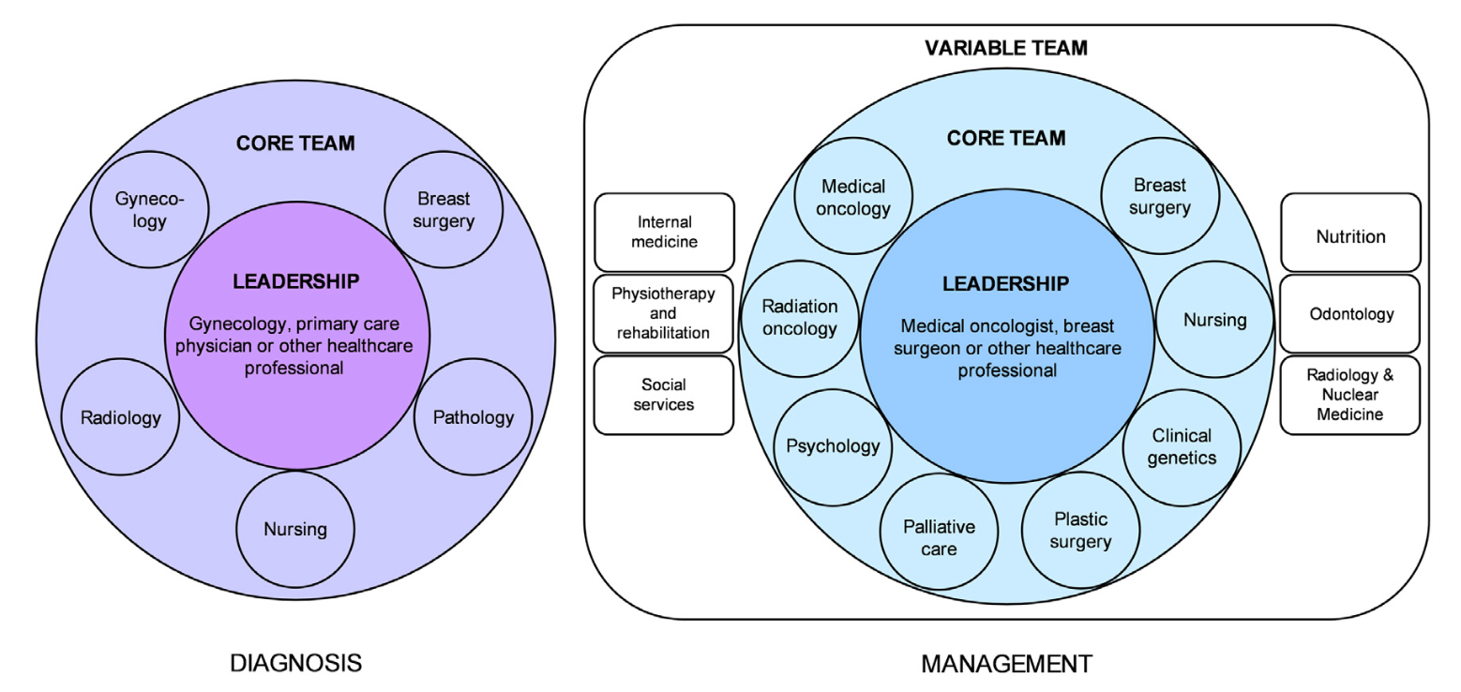
Multidisciplinary Tumor Board - Exemplary Personalized Healthcare
Barrios C, Sánchez-Vanegas G, Villarreal-Garza C, et al. Barriers and facilitators to provide multidisciplinary care for breast cancer patients in five Latin American countries: A descriptive-interpretative qualitative study.
Lancet Reg Health Am. 2022;11:100254. Published 2022 Apr 7. doi:10.1016/j.lana.2022.100254
Notes:
In clinic the diagnosis and management of patients is carried out by a team of specialists, the so-called multidisciplinary tumor board, which includes radiologists, oncologists, surgeons, gynecologists and other professionals shown here in this slide.

Slide 9
Cancer Prevention Guidelines
Risk-reducing bilateral mastectomy - removal of patient’s breasts
Risk-reducing salpingo-oophorectomy - removal of patient’s ovaries and fallopian tubes
Lifestyle modification – obesity, alcohol use, physical activity, reproductive patterns
Clinically available risk-reducing medication – tamoxifen, raloxifene, exemestane, anastrozole
Notes:
When it comes to preventative strategies, currently there are only a few options available: surgical intervention, modification of lifestyle or the use of medication such as tamoxifen and raloxifene, which are the partial estrogen antagonists.
Tamoxifen, raloxifene - selective estrogen receptor modulators (SERMs)
Exemestane, anastrozole - inhibit conversion of androgens to estrogen
Clinically available risk- reducing medication. Risk-reducing medication is an important prevention option for women at increased risk of breast cancer who do not
wish to undergo (or who wish to postpone) risk- reducing mastectomy or whose risk is increased but not elevated enough for surgery to be considered appropriate. The risk-reducing medications recommended in international guidelines are the SERMs tamoxifen and raloxifene, and the aromatase inhibitors exemestane and anastrozole (see Table 2). None of these has been
shown to reduce breast cancer mortality, and all of them are only able to reduce the risk of ER- positive breast cancer. Nevertheless, ER- positive breast cancer is the most common type, and avoiding a breast cancer diagnosis and subsequent treatment, even if that breast cancer was not going to result in premature mortality, seems a worthwhile goal in terms of reducing the burden on the health- care system, women and their families. Tamoxifen is the best- studied risk- reducing medication and is the only preventive agent that has been demonstrated to be effective in premenopausal and postmenopausal women. It reduces the ER- positive breast cancer risk by 33% (ref.202), with the risk reduction seen not only during the 5 years of taking the medication but also for at least 15 years after cessation203. Reductions in MD in tamoxifen users correlate with its preventive efficacy110. However, side effects of tamoxifen can
include menopausal symptoms, such as hot flushes, and a doubling of the risk of thrombosis, although the absolute risk remains low, particularly in younger women204. Tamoxifen also doubles the risk of endometrial cancer in postmenopausal women, although again the absolute risk is small204. Another major impediment to uptake of tamoxifen by premenopausal women for a 5- year period is the inability to prescribe it safely in women who are trying to conceive, who are pregnant or who are lactating and the fact that women need to use a non- hormonal
form of contraception205.
Raloxifene, another SERM, has only undergone trials in postmenopausal women. Raloxifene (60 mg daily for 5 years) was compared directly with tamoxifen
(20 mg daily for 5 years) in the STAR trial, and at the 81- month median follow- up raloxifene was only 76% as effective at reducing ER- positive breast cancer compared
with tamoxifen, but without the increased endometrial cancer risk seen with tamoxifen and with fewer thromboembolic events206. Risks and benefits of treatment
with raloxifene or tamoxifen in postmenopausal women depend on age, ethnicity, breast cancer risk and hysterectomy status. Risk–benefit tables have been published
for both tamoxifen and raloxifene that can help identify groups of women for whom the benefits of these risk- reducing medications outweigh the risks207.
Aromatase inhibitors are more effective than either of these agents but can only be used in postmenopausal women, where in most cases they should be the agent
of first choice, with tamoxifen or raloxifene reserved for those who cannot tolerate them. Tamoxifen remains the clear treatment of choice for premenopausal women,
with continued benefits up to at least 20 years after initiation203. Long- term follow- up is highly desirable for raloxifene as prevention is a long- term issue.
Randomized controlled trials of the aromatase inhibitors exemestane and anastrozole have also shown that these medications can reduce the breast cancer risk
by 60% at a median 2.5 years of follow- up and by 49% at a median 10.9 years of follow- up, respectively208–210.
These medications can only be used in postmenopausal women as they are ineffective in women with functioning ovaries.
Despite the clear benefits of risk- reducing medication, uptake is low among women at increased risk211,212.
The reasons for this are complex and both clinician and patient related. There is a lack of clarity over the most appropriate type of clinician to initiate discussions about
risk- reducing medications182,211, in addition to clinicians having difficulty using the existing risk assessment models211,213 and preferring to have a tool that links risk
assessment with risk management213. Furthermore, clinicians often lack deep knowledge about prevention medications214–216 and are concerned over the lack of surrogate
markers for the effectiveness of preventive medications as well as the overall lack of commercial interest in prevention211.
The latter concern comes about because all current prevention medications were off- patent by the time their role in prevention was proven. Thus, unlike
newer patented drugs, where companies have a commercial incentive and spend considerable proportions
of their budget educating clinicians about their drug, there is no investment to educate clinicians about implementing
these older, generic prevention medicines into their practice. Additionally, in some countries/regions in
Europe and in Australia, there is a lack of a clear pathway for regulatory approval of repurposed, off- patent drugs.
Tamoxifen was shown to reduce breast cancer risk in 1998 (ref.217) and was promptly approved by the US Food
and Drug Administration (FDA) for primary prevention, but in Australia regulatory approval was not sought
until 2016 and only then after substantial advocacy by clinicians and consumer groups. Lack of regulatory
approval in Australia before 2016 was a factor in the low rate of tamoxifen prescriptions214.
The major patient factor contributing to low uptake of risk- reducing medications is said to be fear of side
effects218,219. However, in the main prevention trials, which included over 13,000 women who took preventive
medication, 5- year adherence to the study drug or placebo was approximately 70%. Importantly, there
was only at most a 5% difference between the intervention and placebo arms with regard to the proportion of
women who ceased the study drug or placebo because of side effects209,210,217,220. This demonstrates that much of
the symptomatology experienced by women taking preventive medicines is background symptomatology
rather than due to the medicines themselves. Clinician recommendation and the way clinicians frame information
about side effects are important. For example, regarding the risk for endometrial cancer for postmenopausal
women, it may be better to frame the risk as ‘approximately 996 in every thousand women can take
tamoxifen for 5 years without getting endometrial cancer’, rather than ‘your risk is doubled’. Few online tools
are available currently to help clinicians balance absolute benefits against absolute risks for individual women183.
Clinicians should also be sure to convey not only potentially adverse side effects but also beneficial ones, such
as, for example, the potential for decreased breast tenderness, lighter menstrual periods, better bone density
and lower cholesterol for women considering tamoxifen use. Clinicians should also consider offering women a
short trial of 6–8 weeks of risk- reducing medication to assess their tolerance and so that women do not feel they
are committing to a 5- year course with no knowledge of how well they, as an individual, will tolerate the drug. If
such a short trial also had a biomarker of effectiveness, it may assist women in drug adherence.
Other patient factors that limit uptake of tamoxifen for ER- positive breast cancer risk reduction include the
fact that it is a cancer drug, the experience of others (usually those with cancer) and the tablet being a daily
reminder of their increased cancer risk; although the latter can presumably also work in reverse, with some
women reassured by the daily tablet that they are actively reducing their breast cancer risk218. Importantly, it has
also been shown that women often confuse tamoxifen with chemotherapy, and this has led to recommendations
that the word ‘chemoprevention’ should be avoided218,221 with ‘risk- reducing medication’ seemingly a more appropriate term.

Slide 10
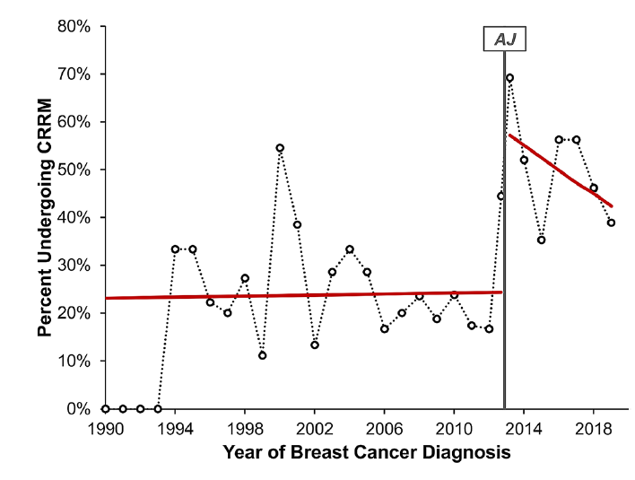
The Angelina Effect
Basu, Narendra Nath et al. “The Angelina Jolie effect: Contralateral risk-reducing mastectomy trends in patients at increased risk of breast cancer.” Scientific reports vol. 11,1 2847. 2 Feb. 2021, doi:10.1038/s41598-021-82654-x
Notes:
Angelina Jolie chose the surgical intervention. She was extremely brave to share her choice publicly, which brought attention to the issue and helped raise awareness among the population.
Some researchers have tried to measure the extent of her actions and indeed observed the surge increase in women referrals with a family history of breast cancer, an increase in genetic testing (specifically for BRCA1 and BRCA2 genes) and an increase in the cases of preventive surgery.
What is quite interesting is that it’s not the first instance of this effect. Another notable instance was Nancy Reagan, who underwent mastectomy and also publicly announced about her decision in 1987. It led to the similar effect in patient-decision making, however, more moderate.
It quite vividly demonstrates the impact of high profile personalities on health related issues.
Contralateral risk-reducing mastectomy (CRRM)
On May 14th 2013, Angelina Jolie (AJ) shared with the world her experience of bilateral risk reducing mastectomies (BRRMs)11 based on her inheriting a maternally derived pathogenic variant mutation in the BRCA1 gene. Since this revelation, numerous changes in healthcare practices have been reported—the so-called “Angelina Jolie Effect”12. These include a 250% increase in referrals of women with a family history of breast cancer in the UK13, increases in rates of BRRM14 and health insurance reimbursement for BRCA testing15–17. In 2015, Angelina
Jolie wrote about her experience with risk reducing salpingo-oophorectomy18—the effect of this on risk-reducing gynaecological surgery is yet to be determined.
Healthcare professionals need to be aware of the impact high profile personalities can have on health related issues.
In 1987, Nancy Reagan’s well publicised decision to undergo a mastectomy19 over breast conservation in the USA resulted in a 25% reduction in the use of breast conservation, sparking a media frenzy with headlines claiming that such a personally publicised decision “set us back 10 years”20.

Slide 11
Breast Reconstruction
Autologous – tissue flaps
- Longer surgical procedure
- Longer recovery period
- Lifetime solution
Possible complications:
- Necrosis of the transferred tissue
- Formation of blood clots
- Adverse effects at the donor site
Implant-based – artificial materials (silicone, saline)
- Shorter surgical procedure
- Shorter recovery period
- Multiple steps and many follow-up visits
- Not a lifetime option
Possible complications:
- Implant rupture and extrusion
- Formation of scar tissue, hematoma, blood clots
https://www.cancer.gov/types/breast/reconstruction-fact-sheet#:~:text=Breasts%20can%20be%20rebuilt%20using,used%20to%20rebuild%20the%20breast.
Malekpour M, Malekpour F, Wang HT. Breast reconstruction: Review of current autologous and implant-based techniques and long-term oncologic outcome. World J Clin Cases. 2023;11(10):2201-2212. doi:10.12998/wjcc.v11.i10.2201
Notes:
In autologous tissue reconstruction, a piece of tissue containing skin, fat, blood vessels, and sometimes muscle is taken from elsewhere in a woman’s body and used to rebuild the breast. This piece of tissue is called a flap.

